Slide 1

Machine Learning ii Pump it up: Data mining the water table
Group O-1-6
LOUIS DUBAERE
JUAN PABLO GARCÍA GÓMEZ
FRANZ-ANTON GRAF BASSELET VON LA ROSEE
SIYAO LU
ANDREW MARTINEZ
STEPHANIE NJERENGA
TOMAS TELLO GARCÍA

Slide 2

Table of contents
Purpose
Feature Engineering
Model Stacking
Dimensionality Reduction
Data Exploration and Preparation
Final Results

Slide 3
Purpose
Seeking to predict functionality status of pumps in Tanzania.
Categorized as Functional, Non-Functional, and Functional with Repair.
Data provided includes a combination of numerical, geographic, and categorical information.

Slide 4
Data Exploration and preparation
Numerical Values
Geographic Mean impute (i.e. longitude, latitude, population, etc.)
Categorical Values
Remove columns that are too similar to other columns or have too many unique values.
Otherwise reduce number of categories via percentage thresholds.
Standardize, fix skewness, and clip outliers.

Slide 5
Feature Engineering
Ad-hoc Features:
Distance from Capital- helpful
Age/Years of Operation- somewhat helpful
Genetic Programming- helpful
Polynomial Features- unhelpful
Introduction of Outside Data (weather and population) – somewhat helpful

Slide 6
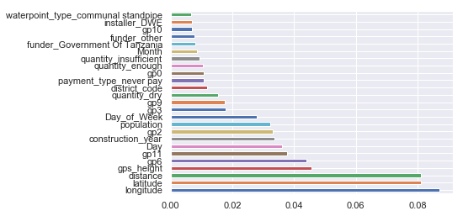
Dimensionality reduction
Principal Component Analysis- not useful
Recursive Feature Elimination (RFECV) with and without PCA- computationally expensive
Features of Importance via Random Forest

Slide 7
Model Stacking
Random Forest was selected for baseline and as meta model.
Ensembles include Gradient Boost, Random Forest, and KNN.
Triplet ensembles tuned to predict each category via Randomizedsearchcv.

Slide 8
Ensemble diagram
Final Meta (Random Forest)
Functional Probabilities
Random Forest
Best CV Tuned Score: 0.82
Gradient Boosting
Best CV Tuned Score: 0.81
Non-Functional Probabilities
Random Forest
Best CV Tuned Score: 0.86
Functional with Repair Probabilities
KNN
Best CV Tuned Score: 0.80
KNN
Best CV Tuned Score: 0.83
Gradient Boosting
Best CV Tuned Score: 0.84
Random Forest
Best CV Tuned Score: 0.93
KNN
Best CV Tuned Score: 0.93
Gradient Boosting Trees
Best CV Tuned Score: 0.94

Slide 9
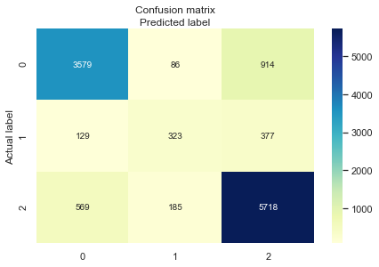
Final Results
Final model a fair job of predicting in training (approx. 81% accuracy) without significant overfitting on test holdout (approx. 80.6%).
Other methodologies appeared to perform better in training, but with significant overfitting in holdout.
Weakest prediction power for Functional with Repair despite this having the highest accuracy in individual training.
Functional: 2
Functional with Repair: 1
Nonfunctional: 0

